Slide 1


Slide 2

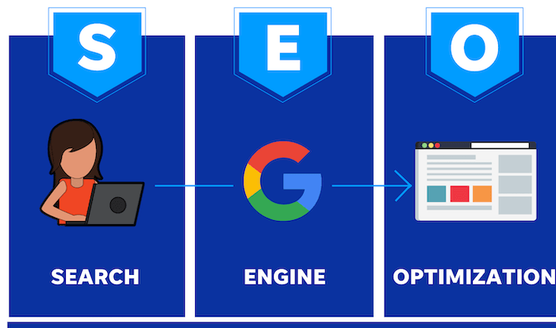
DEFINITION
Search engines are programs that search documents for specified keywords and returns a list of the documents where the keywords were found.
Some of the popular Search Engine are Google,Yahoo,Bing e.t.c

Slide 3
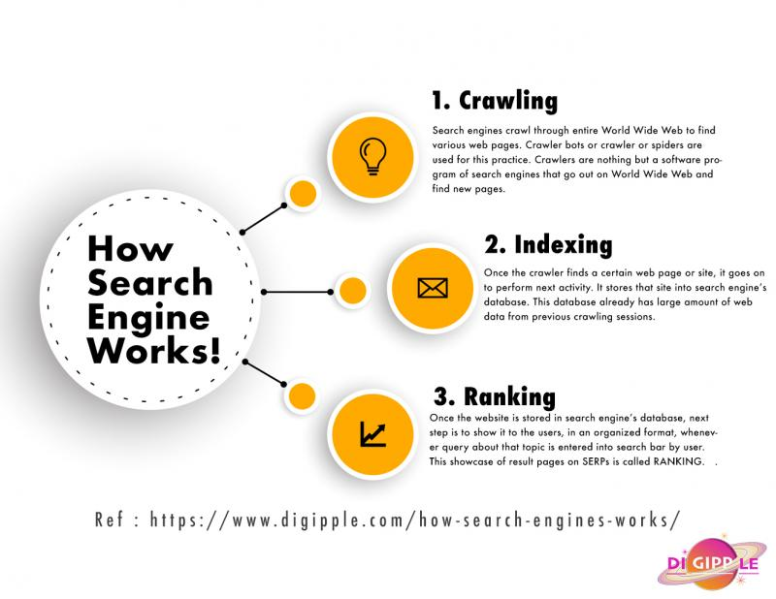

Slide 4
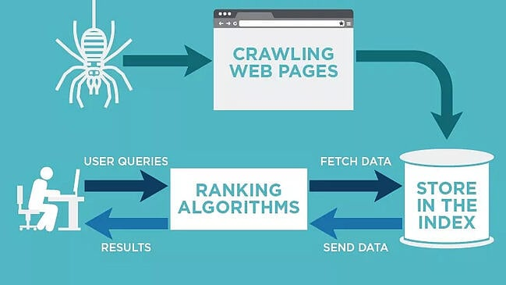
Working of Search Engine
A Search Engine operates is a three manner-:
​
Web Crawling
Indexing
Ranking and Serving Results

Slide 5
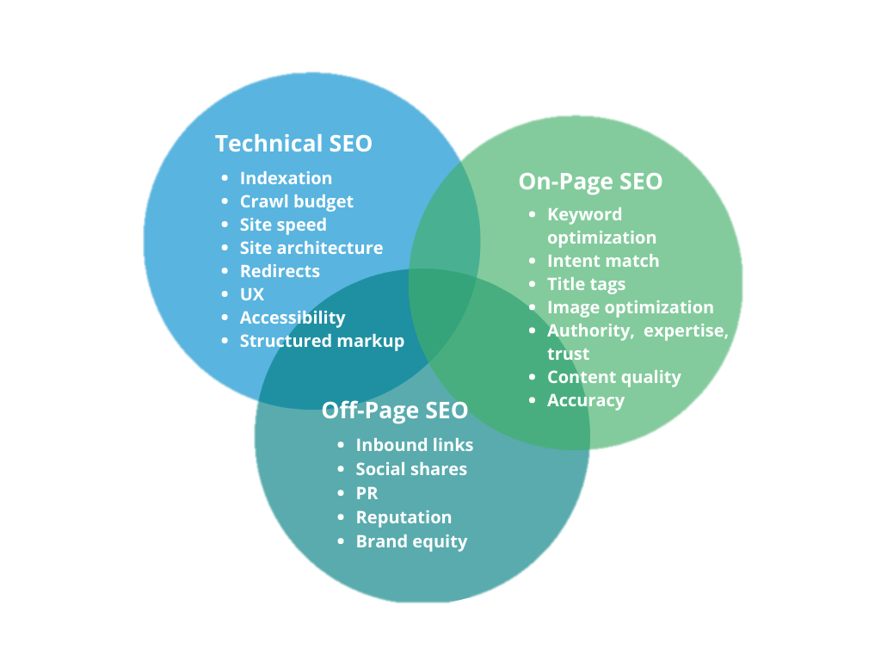
Types OF SEO

Slide 6
Types OF SEO
ON PAGE SEO
REFERS AS OPTIMIZING THE PARTS OF YOUR WEBSITE YOU CONTROL LIKE
HTML
TITLE
META DESCRIPTION
URL
OFF PAGE SEO
FOCUSES ON THE RANKING FACTORS THAT OCCUR OUT SIDE OF YOUR WEBSITE LIKE BRAND MENTIONS
Social links
Domain authority
Technical SEO
Technical aspects like
Web pg speed
Structure of web pg
Site map
Redirect 404 links
Mobile friendlenss
TECHNIQUES TECHNIQUES
BLACK HAT GRAY HAT WHITE HAT
BLACK HAT GRAY HAT WHITE HAT

Slide 7
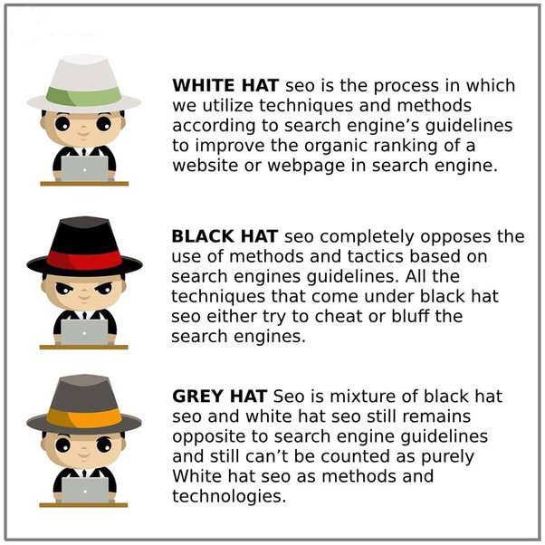
TYPES OF SEO

Slide 8
Types OF SEO
ON PAGE:
• HTML tags:
Page Titles, Meta Descriptions, Headers are the HTML tags that must be optimized. Visitors see page titles in the search results. Meta description tags describe the contents of the page. Header tags are used to give headings on the page. These tags give specific information about a page to search engines and browsers. Key points to remember
o Give a unique and descriptive title.
o Include keyword in the title.
o A title can have a maximum of 60 characters.
o Meta description should briefly summarize the content on the page. Ensure to keep them within 155 characters.
o Heading should be unique and interesting. It should include the primary keyword or phrase for which the page is optimized for. Follow heading hierarchy, that is H1 to H6. Include related keywords and phrases in the subheadings.

Slide 9
Types OF SEO
OFF PAGE:
Gaining relevant traffic – Off-page SEO is the act of presenting a business' products and services to the online community. A company’s off-page SEO strategy could include message boards, online communities, or social media sites such as Google+, YouTube, Twitter, Facebook, and LinkedIn. This process helps in generating relevant search engine traffic to a Website or blog. Any content published by a business must use keywords that are relevant to its business sector
Link building - It is the process of getting links from other Websites to one’s site. There are several techniques One can write press releases, submit them to directories and news sites. One can develop content that creates links naturally. Link-building is one of the main components of the site’s ranking in Google. The number of links pointing to a page is one of the most important factors affecting ranking. Google considers links from relevant and authoritative sites only
Improving Website ranking on SERPs – One can gain new and relevant links to the Webpage from quality authoritative sites, social media, and social bookmarking sites. These backlinks keep working in the background to help improve the search rankings

Slide 10
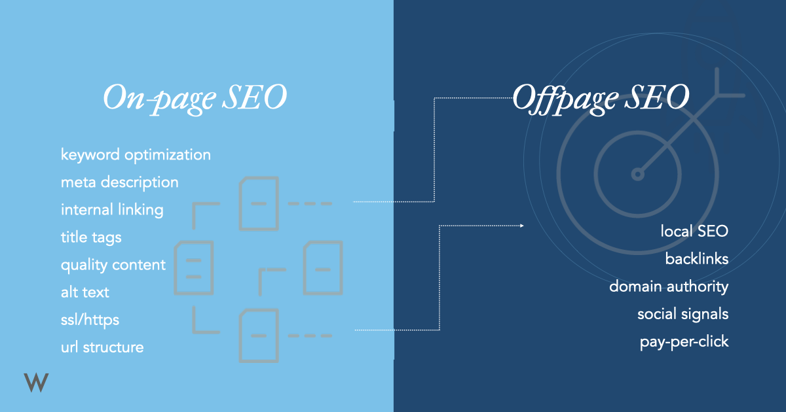
Types OF SEO

Slide 11
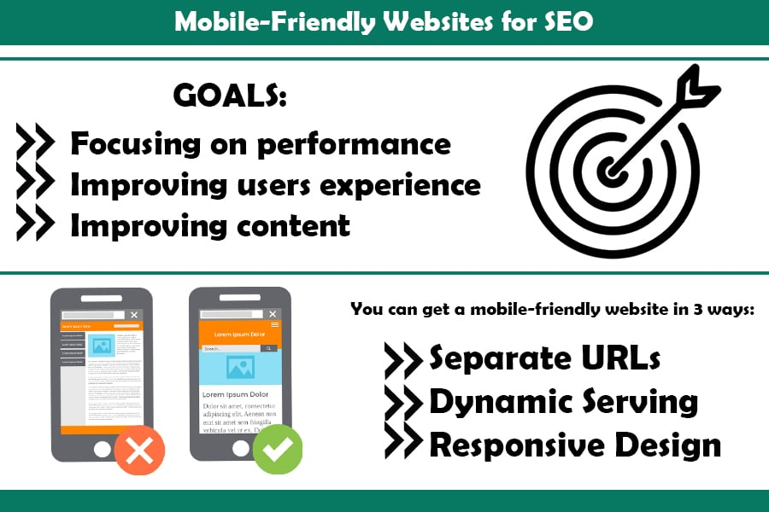
Mobile SEO
Mobile SEO :
The practice of optimizing a Website to rank highly in mobile search results is called mobile SEO. Mobile SEO can be implemented on a site that uses responsive Web design, which means the Web content automatically adjusts to any device that is used - tablets, smartphones, or laptop;
SEO for mobile devices is different from SEO for computers because of specific user behaviors. According to Google, more searches are now done from mobile devices than from desktop computers. It is vital that the Website content be optimized for mobile devices and viewed in a way that enhances the user experience. Mobile users are different and demand more user-friendly approaches on a smaller screen
A responsive Web design:
• Allows for sharing of content with a single URL.
• Ensures that a single Googlebot user agent crawls the page efficiently.

Slide 12
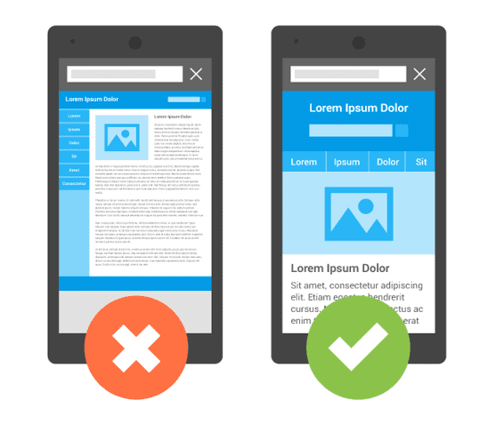
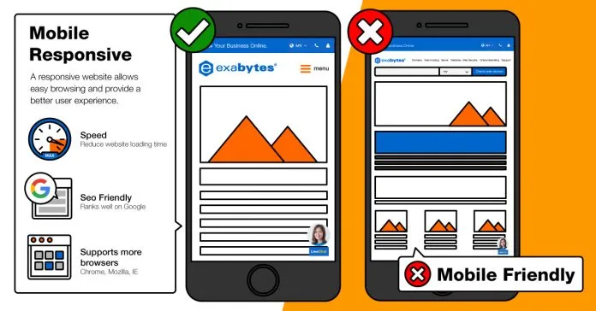
Mobile SEO
RESPONSIVENESS

Slide 13
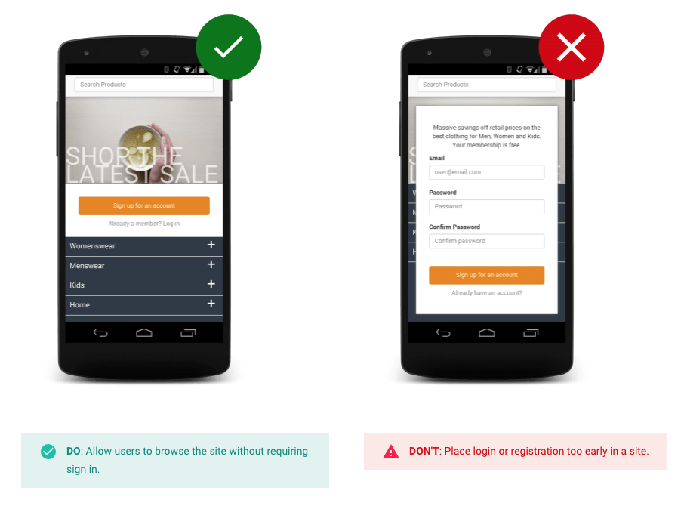
Mobile SEO
DESIGN

Slide 14
Mobile SEO
Positive Factors
Accelerated Mobile Pages
Compressed Images
Mobile-friendly Keywords
Social Signals
Local SEO
Negative Factors
Crawl Errors
Too many ads
Small Fonts
Intrusive Interstitials
Small Touch Elements

Slide 15
Mobile SEO
Positive Factors
Accelerated Mobile Pages – It is called the AMP framework. It is an open-source tool to create efficient mobile Web pages.
• Compressed Images - Compress images for faster loading.
• Mobile-friendly Keywords - Because typing on mobile devices is cumbersome, users often use short search terms instead of longer ones. The aim of mobile keyword research is to identify keywords likely to be used by mobile users.
• Social Signals – These refer to the engagement that online content receives on social media platforms in the form of comments, likes, and shares.
• Local SEO - As most mobile users search for local businesses, such as “bakery near me” and “chess classes near me”, it is important to include local SEO
Negative Factors
Crawl Errors- These errors do not allow search engines to crawl. Google’s Search Console provides comprehensive reports on crawl errors and also guides on how to resolve them.
• Too many ads - Advertisements can destroy the experience of a Website and must be kept to a minimum. A user can accidentally click an ad while scrolling the content, which is distracting and irritating
Small Fonts - An ideal mobile font size would be 16 pixels, so that visitors can comfortably read the copy from a comfortable distance. A smaller font size would make users pinch and zoom, which is an undesirable user experience. • Intrusive Interstitials - Google does not rank Web pages that use intrusive interstitials, which are popup ads that block most of mobile landing page (and thus frustrate users). Furthermore, such pages also offer a poor user experience because they cover the main content. Users have to dismiss such ads before accessing the main content. • Small Touch Elements - When elements are placed close to each other, it can result in a poor mobile experience. For example, user intends to tap on one button but taps the next button instead. It is important to use plenty of negative space between elements. (Negative space refers to the empty space around an object.) It should also be ensured that touch elements are not too small or too close together.

Slide 16
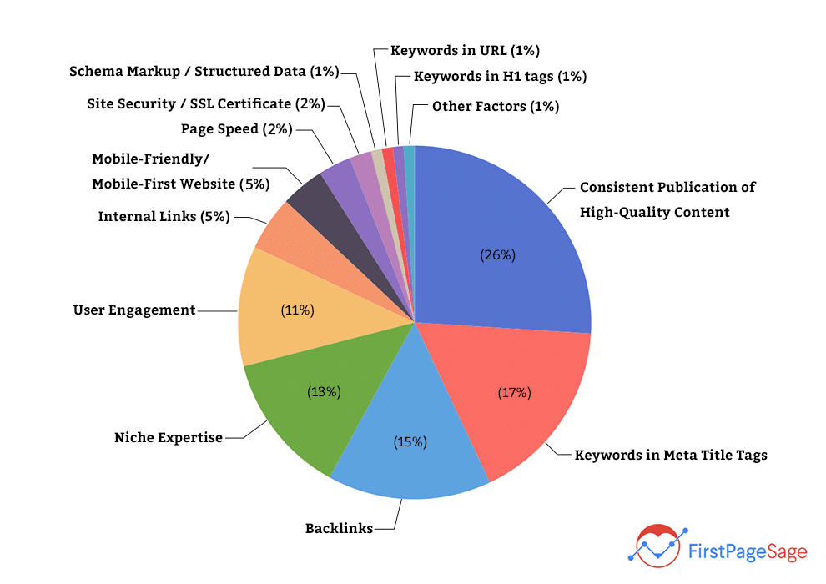
SEO algorithm
Google search algorithm:
Google search algorithm is a complex system that allows Google to find, rank and return the most relevant pages for a certain search query. To be precise, the whole ranking system consists of multiple algorithms that consider various factors such as quality, relevance or usability of the page
In its early years, Google only made a handful of updates to its algorithms. Now, Google makes thousands of changes every year.
Most of these updates are so slight that they go completely unnoticed. However, on occasion, the search engine rolls out major algorithmic updates that significantly impact the SERPs

Slide 17
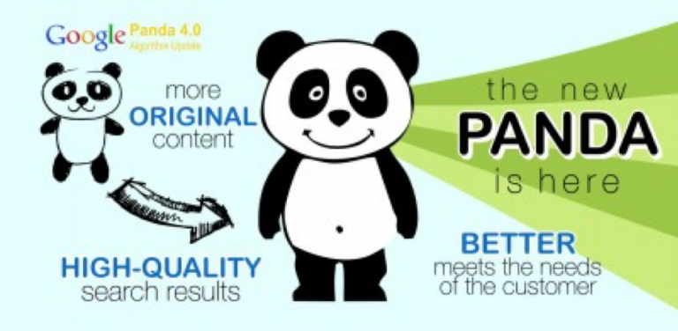
SEO algorithm
Here’s a list of the most well-known algo updates in the last decade that shaped the way Google algorithm works:
Panda (2011)
Google Panda is a filter focused on low-quality pages, thin content, keyword stuffing and duplicate content. It was incorporated into the core algorithm in 2016 and rolls out regularly
According to Google, Panda’s initial rollout over the course of several months affected up to 12 percent of English language search results. We've tracked 28 data updates to Panda between 2011 and 2015.
Important points noted here about Panda Algo:
It can identify content that is shallow, poorly written, or copied from other websites.
Poorly written content can hurt rankings.
Removing low-quality pages from part of a website can help high-quality pages rank better.
Improving content (making it "useful") can help your rankings.

Slide 18
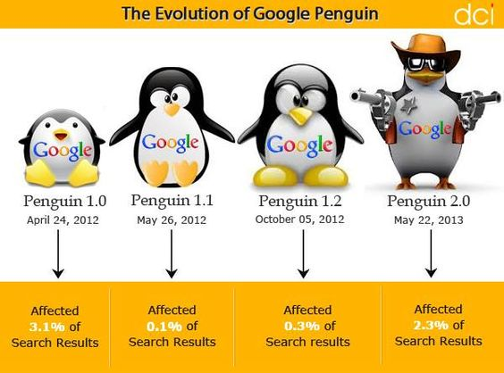
SEO algorithm
Here’s a list of the most well-known algo updates in the last decade that shaped the way Google algorithm works:
Penguin(2012)
Hazards: Spammy or irrelevant links; links with over-optimized anchor text. How it works: Google Penguin’s objective is to down-rank sites whose backlinks look unnatural. This update put an end to low-effort link building, like buying links from link farms. How to adjust: To stay safe from the effects of the Google Penguin update, monitor your link profile’s growth and run regular audits with a backlink checker like SEO SpyGlass. In the tool’s Summary dashboard, you’ll find a progress graph for your link profile’s growth. Look out for any unusual spikes: those might be the result of a negative SEO attack by your competitors.

Slide 19
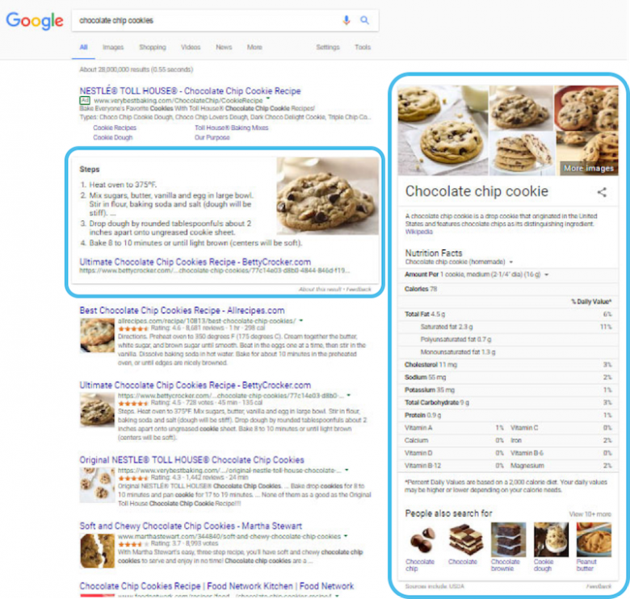
SEO algorithm
Here’s a list of the most well-known algo updates in the last decade that shaped the way Google algorithm works:
Hummingbird (2013)
Hummingbird update improved the way Google understands and interprets search queries; a shift from exact keywords to topics
Example:
You can see the knowledge graph in action on the results page yielded upon searching for “chocolate chip cookies.” The SERP does contain standard organic results and links to suitable websites, but it also contains a rich set of knowledge graph data, including an answer box with a recipe, a right-hand knowledge panel featuring nutritional facts about this dessert, and suggestions for related search subjects.

Slide 20

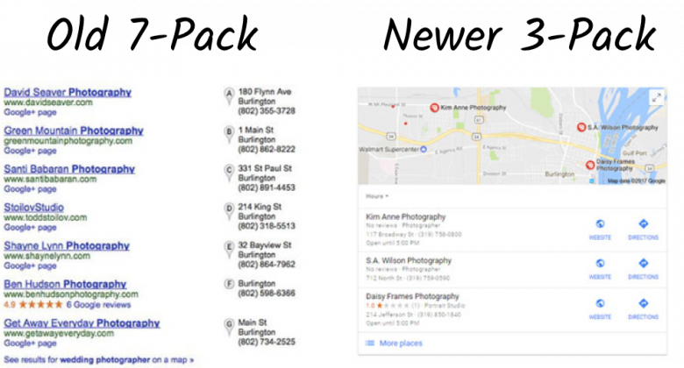
SEO algorithm
Here’s a list of the most well-known algo updates in the last decade that shaped the way Google algorithm works:
Pigeon (2014)
Pigeon focused on the improvement of the local results both in terms of quality and accuracy.

Slide 21
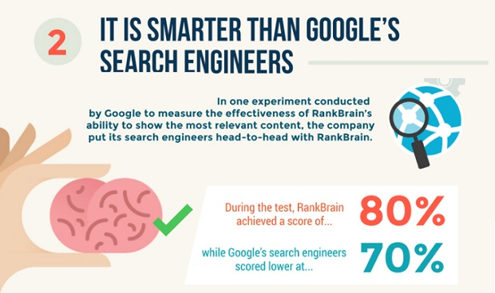
SEO algorithm
Here’s a list of the most well-known algo updates in the last decade that shaped the way Google algorithm works:
RankBrain (2015)
As mentioned earlier, RankBrain is a machine-learning component of Google’s Hummingbird algorithm that helps provide more relevant search results.
RankBrain is a part of Google’s Hummingbird algorithm. It is a machine learning system that helps Google understand the meaning behind queries and serve best-matching search results

